Slide 1
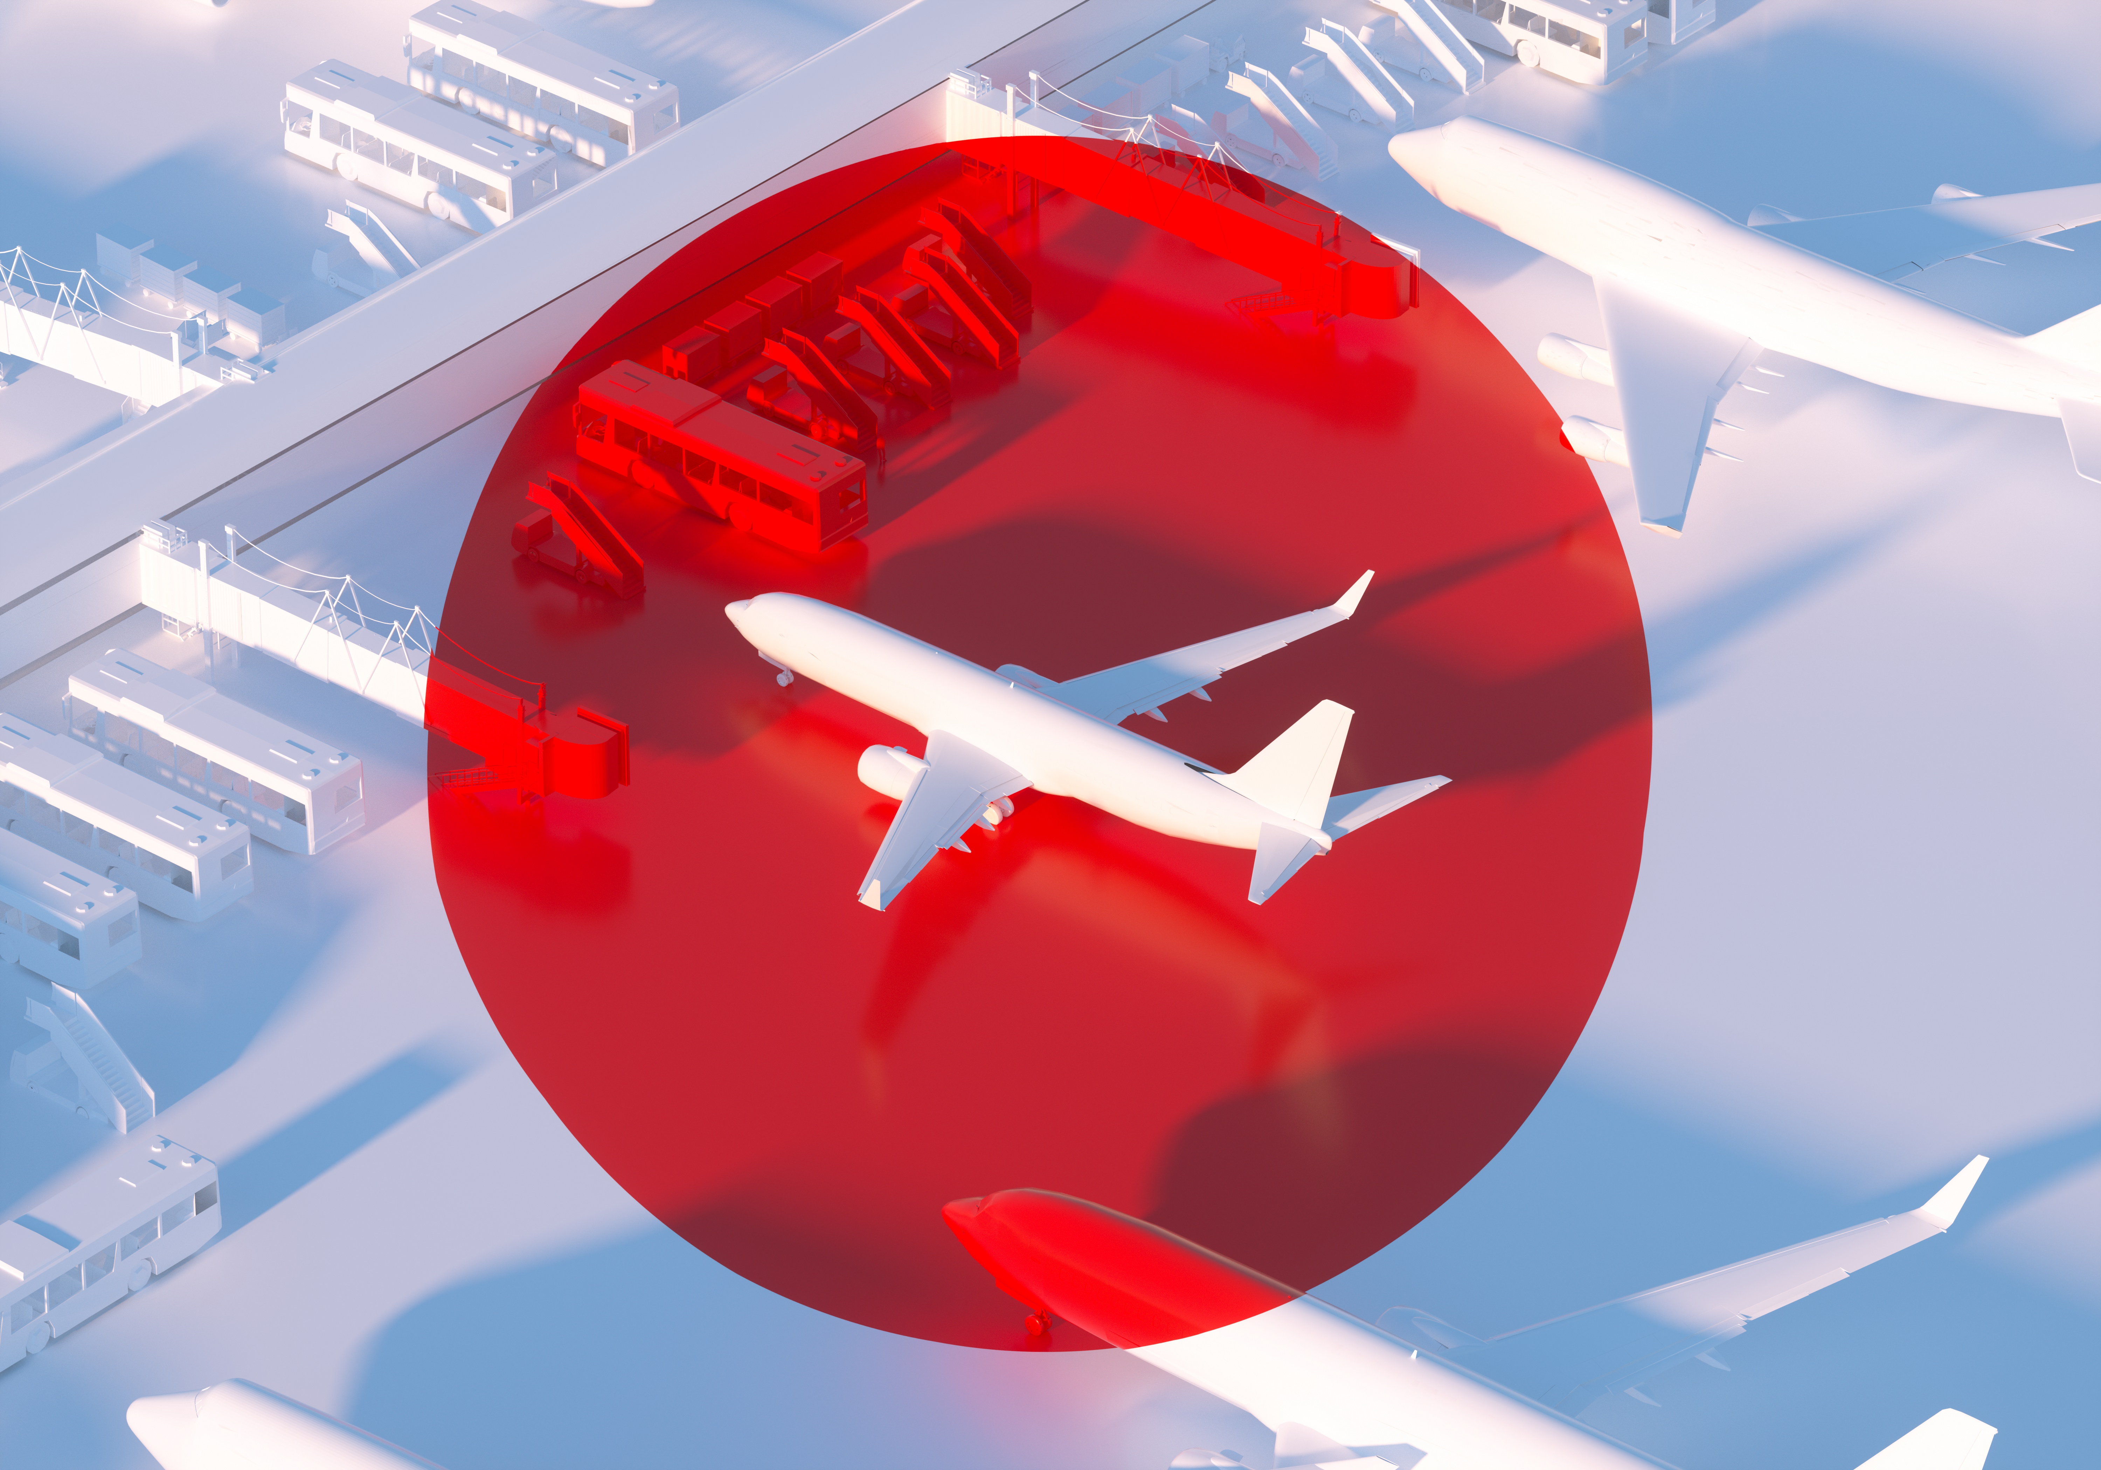
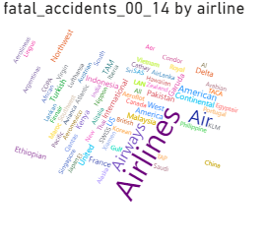
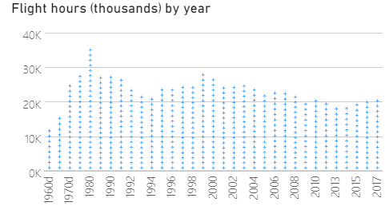
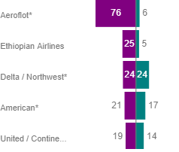

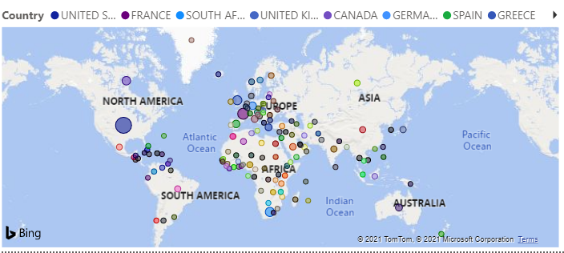
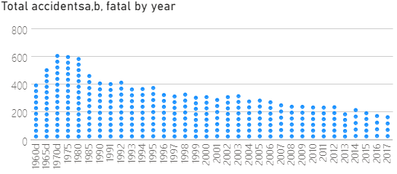
Sample 2
Travel:
Fly safely
Fly safer than ever, each year flying get a lot safer with fewer accidents and more flights in many more countries as we try and connect the globe
Safety is the number one priority of airlines and the data shows that is the trend over the years

